Slide 1

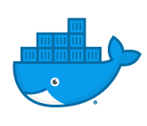
docker and kubernetes
Notes:
Attention!
Before you open this template be sure what you have the following fonts installed:
Bebas Neue
http://www.fontsquirrel.com/fonts/bebas-NEUE
Aller
http://www.fontsquirrel.com/fonts/Aller
Icon Sets Font:
http://www.webhostinghub.com/glyphs/
All fonts are permitted free use in commercial projects.

Slide 2

Vitals check
How are we feeling about the class so far?
Lost on anything?
Questions from yesterday?
Are you happy with the teaching style so far?
What adjustments can I make to help?
Is the pace OK?

Slide 3

RV store kubernetes hackathon

Slide 4

Rv store

Slide 5
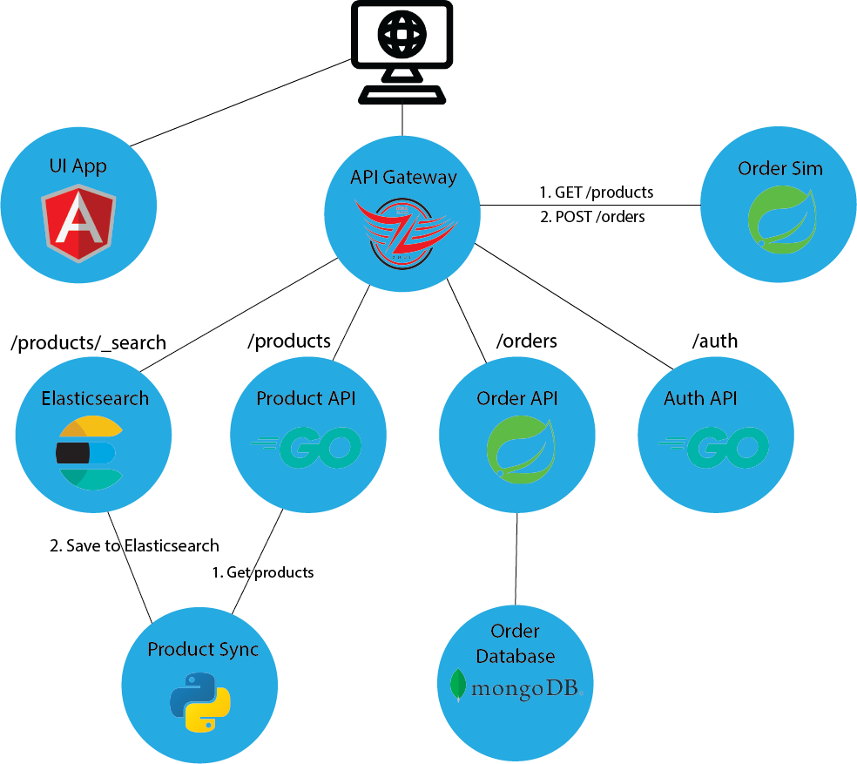
RVStore - overview

Slide 6

hackathon - overview
The RV store is a mock ecommerce application.
Your task is to get the application running on a Kubernetes cluster.
The application has the following services, each with their own Docker image:
Angular UI running in Nginx
Authentication service
Product service
Order service
Order simulator
Gateway edge service
Product sync service
Product search service (Elasticsearch)
Solutions are provided in the Github repo. But try to only use them to get unstuck on a specific problem!
Github repo is at https://www.github.com/VergeOps/k8s-rvstore

Slide 7
hackathon - objectives
Your humble instructor is playing the role of developer. I’ve written an application made up of 6 services. But I need your expertise to get it running on Kubernetes. All I know is the application code and environment variables needed.
Your goals are (in order of importance):
Set up the application to run in Kubernetes. For this hackathon, Minikube or Docker Kubernetes for Desktop is fine.
Use ConfigMaps to provide environment variables, inject product data, and put any sensitive information into secrets.
Ensure that only public services are accessible outside the cluster. These are the gateway service and the UI.
Make the app fault-tolerant
Multiple copies of services
Set up probes
For MongoDB, set up a volume mapping to your hard drive so that the MongoDB pod can be thrown out and not lose orders.
If we covered HorizontalPodAutoscaler in this class, try adding scaling to one of your deployments, like the product API.

Slide 8
hackathon – learning through the pain
Exercises so far have been very simple and superficial. This is by design, as I want you to get the deep dive knowledge from this hackathon.
This hackathon is designed to push you. It is intended to make you a little uncomfortable. You may not enjoy it (at least until the end when you have it working)!
The struggle is where the learning is. You will scratch your head, wonder what’s going on. This is designed to mimic real life so that you can troubleshoot, then come to me (the developer) to get the proper information.
Past classes have overwhelmingly told me that this is the best part of the class because students come away with a solid foundation of Docker and Kubernetes and have confidence that they can go implement a real application.

Slide 9
hackathon – helpful hints
It is best to start out as simple as possible. Eliminate any variables that might muddy up what you’re doing.
Pick a service that is the simplest and start there. Implement it, get it running, then move on. Don’t try to just write all the files at once then wonder why things aren’t working. Build from simple to complex in an iterative process. The UI service is a good place to start since it just serves static information and has no dependencies on other services.
Save things like fault-tolerance for later. Don’t use multiple copies of a service yet. Don’t add probes. Save that for once it’s working.
Don’t forget that you can test services directly by making them NodePort, hitting them from other pods, or using kubectl port-forward.

Slide 10
Rv store – UI application
This is an Angular application running nginx to serve the files
The application serves at port 80
This application should be publicly accessible
Docker image: public.ecr.aws/e7e6w2e3/rvstore-ui
No environment variables needed
The UI gets its data by making HTTP calls to the backend gateway API.
<backend>/products to get product information
<backend>/products/_search to search the Elasticsearch instance
<backend>/orders to get order information
<backend>/auth to get auth information
In the UI itself, there is a text box to enter the base URL of the backend gateway service. Note that it must include the trailing slash.

Slide 11
Rv store – product api application
This is a Golang application. It serves up the product information as a REST API.
The application serves at port 9001
The application should only be accessible inside the cluster
Docker image: public.ecr.aws/e7e6w2e3/rvstore-product-api
You must provide an environment variable specifying the internal directory location of the product data: PRODUCT_FILE_LOCATION. I suggest /data/products
You must provide the products.json file to the container in a ConfigMap. Place it inside the container at the same location as the PRODUCT_FILE_LOCATION you gave above.
The products.json file can be found in the exercise files in the rvstore_hackathon directory.
You can test the service at http://<service>/products

Slide 12
Rv store – authentication api application
This is a Golang application. It serves up a JSON Web Token (JWT) in response to a login attempt. It does not take a username/password, but instead gives back a JWT any time the login endpoint is called.
The application serves at port 9003
The application should only be accessible inside the cluster
Docker image: public.ecr.aws/e7e6w2e3/rvstore-auth-api
You can test the service at http://<service>/auth/login

Slide 13
Rv store – order api application
This is a Java Spring Boot application. It receives order data and stores it in the Mongo database
The application serves at port 9002
The application should only be accessible inside the cluster
It communicates with the Mongo service by name rvstore-orders-mongodb
Docker image: public.ecr.aws/e7e6w2e3/rvstore-order-api
Environment variables needed:
SPRING_PROFILES_ACTIVE: compose
You can test the service at http://<service>/orders

Slide 14
Rv store – order simulator application
This is a Java Spring Boot application. It generates random orders and submits them to the order API.
There is no port number for this app. It is not a web app but instead just a background process.
It communicates with the Gateway service at: http://rvstore-api-gateway:9000
This pod should run as a Kubernetes BatchJob, running about once a minute.
Docker image: public.ecr.aws/e7e6w2e3/rvstore-order-simulator
Environment variables needed:
SPRING_PROFILES_ACTIVE: compose
JOB: true

Slide 15
Rv store – elasticsearch
This is the stock Elasticsearch image from Docker Hub. It stores products to make them searchable. The product sync service populates it with products from the product service.
The application listens on port 9200
Run it as a StatefulSet with a single replica.
It communicates with the product service at: http://rvstore-product-api:9001 and the Elasticsearch service at http://elasticsearch:9200.
Docker image: elasticsearch:7.12.0
Environment variables:
discovery.type=single-node
ES_JAVA_OPTS=-Xms256m -Xmx256m
http.cors.allow-origin="*”
http.cors.enabled=“true”
http.cors.allow-headers=X-Requested-With,X-Auth-Token,Content-Type,Content-Length,Authorization
http.cors.allow-credentials="true"

Slide 16
Rv store – api gateway application
This is a Java Spring Boot application. It routes traffic to the appropriate application based on the path. It acts as traffic cop. For example, xyz.com/products will get routed to the product API application
Runs on port 9000
Application should be publicly accessible as the only endpoint for the backend API
It communicates with other services:
Auth service at: http://rvstore-auth-api:9003/auth
Product service at: http://rvstore-product-api:9001/products
Order service at: http://rvstore-order-api:9002/orders
Docker image: public.ecr.aws/e7e6w2e3/rvstore-gateway-service
Environment variables needed:
SPRING_PROFILES_ACTIVE: compose

Slide 17
Rv store – product sync application
This is a Python application. It reads the products from the product service and pushes them to Elasticsearch
The application does not listen on a port
The application can be run on a schedule using a BatchJob.
It communicates with the product service at: http://rvstore-product-api:9001 and the Elasticsearch service at http://elasticsearch:9200.
Docker image: public.ecr.aws/e7e6w2e3/rvstore-product-sync
Environment variable:
JOB: “true”

Slide 18
Rv store – mongodb database
For this we’re using the public mongo image in Docker Hub.
Docker image: public.ecr.aws/e7e6w2e3/rvstore-mongo
Runs on port 27017
Run it as a StatefulSet with a single replica.
Should be accessible only within the cluster
Mongo stores data internally at /data/db
Environment variables needed:
MONGO_INITDB_ROOT_USERNAME: mongoadmin
MONGO_INITDB_ROOT_PASSWORD: secret

